Slide 1
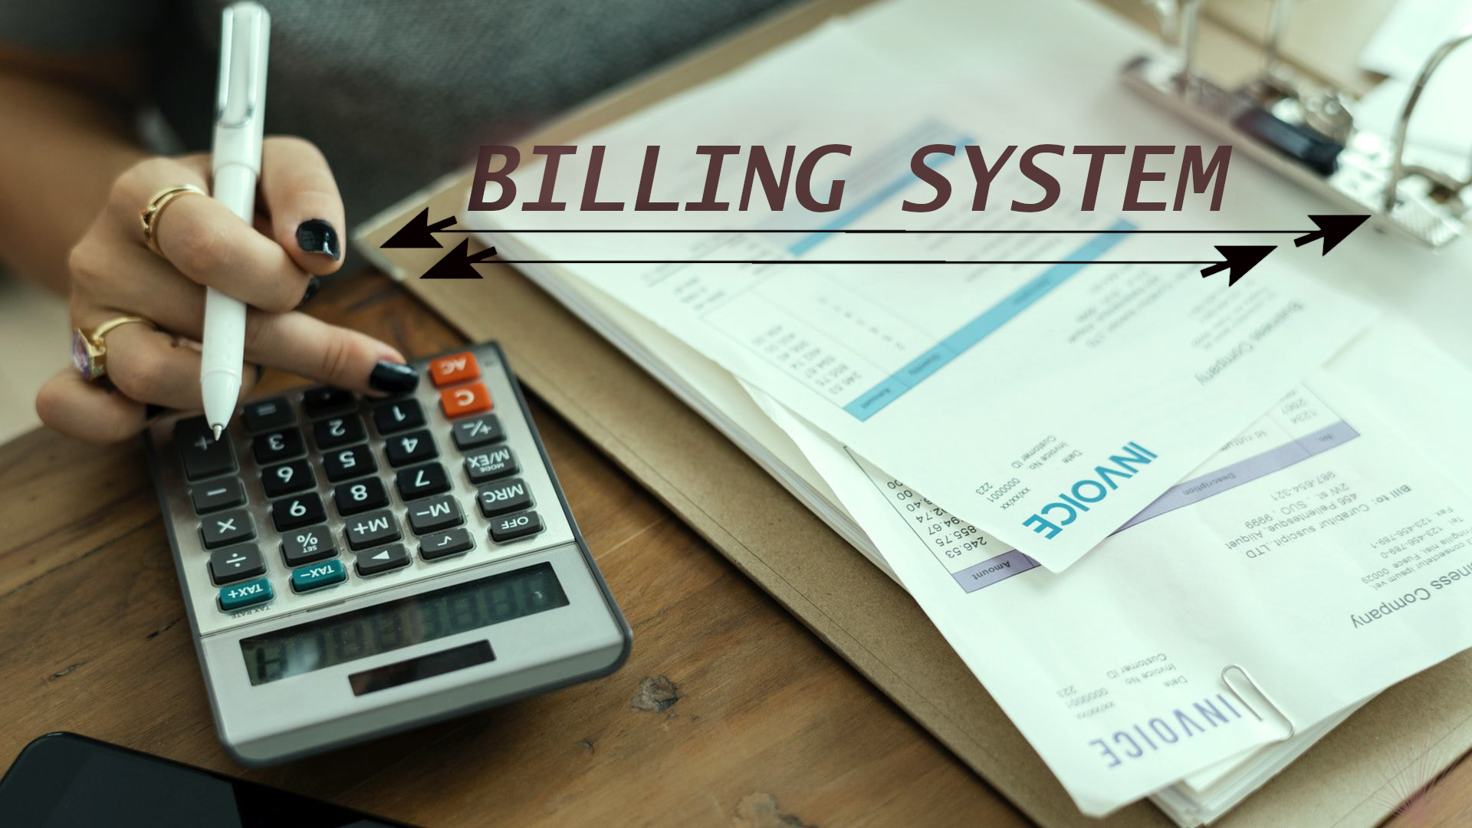

Slide 2
PYTHON GUI PROJECT
COURSE CODE : INT213
SUBMITTED TO : Ms. Gagandeep Kaur
SUBMITTED BY : Group
NAME Registration Number Roll Number
1) Erapani Vinay Kumar 11903967 12
2) Gundu Lalithendra Nath 11904466 40
3) K. Siddartha Roy 11907350 52

Slide 3
OBJECTIVES:
To create GUI of Billing System and understanding its working.
To create user friendly UI.
To understand various modules used in creation of this system.
To gather the information related to Billing and implement in the System.
To connect the multiple windows and maintaining the Perfect Database of user’s entries.

Slide 4
DESCRIPTION OF PROJECT:
Our system includes the following windows:
1)Attractive User Login Window. With all properties like forgot password .
2)To create new account for new users.
3)Display of user’s bill numbers to the respective user.
4)To generate Invoice of the bill entered by user with help of user’s
bill number.
5)To create New Bill. User can entered the item of his own choice and we
show the NET Total and Produce an Invoice of the user item entries.

Slide 5
WORK DIVISION
LALITH VINAY SIDDARTH
LOGIN WINDOW
user login modules
New user module
Forgot password
module
SIGNIN WINDOW
Module to take user
details
Database related to
USER
Connecting window
New User bill
module
Previous user bill
Numbers module
Print Invoice
module
Bill Total Module
Connecting window
Bill Entry Window
Bill info module
Add items module
Display user entry
module
Calculation module
Final User’s
Invoice
This is our Billing
System

Slide 6
ABOUT THE PROJECT:
The user have to Login to The Application.
The user can either create a New bill or see him previous bill numbers or generate Invoice for any of this entered Bills .
In New bill User can create his own bill by entering the Item of his choice and entry the price and Quantity.
The system will show his entries with the Net Total(inclusive of taxes) of the bill.
The system saves the User bill by the Bill number and user can get the Invoice of that Whenever he like to have.

Slide 7
LETS HAVE
A
WALK THROUGH
OF
BILLING SYSTEM
(snapshots)

Slide 8
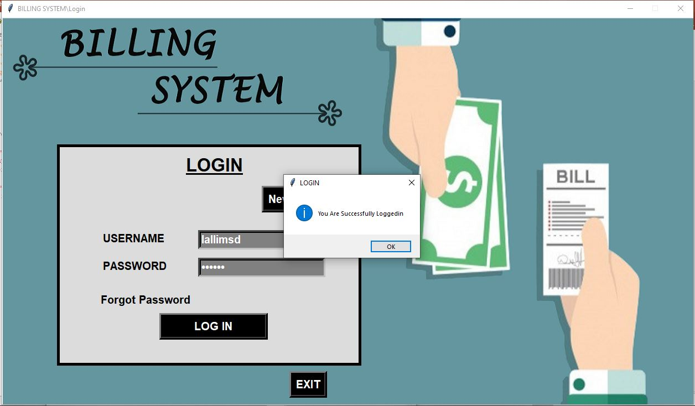
LOGIN INTERFACE :

Slide 9
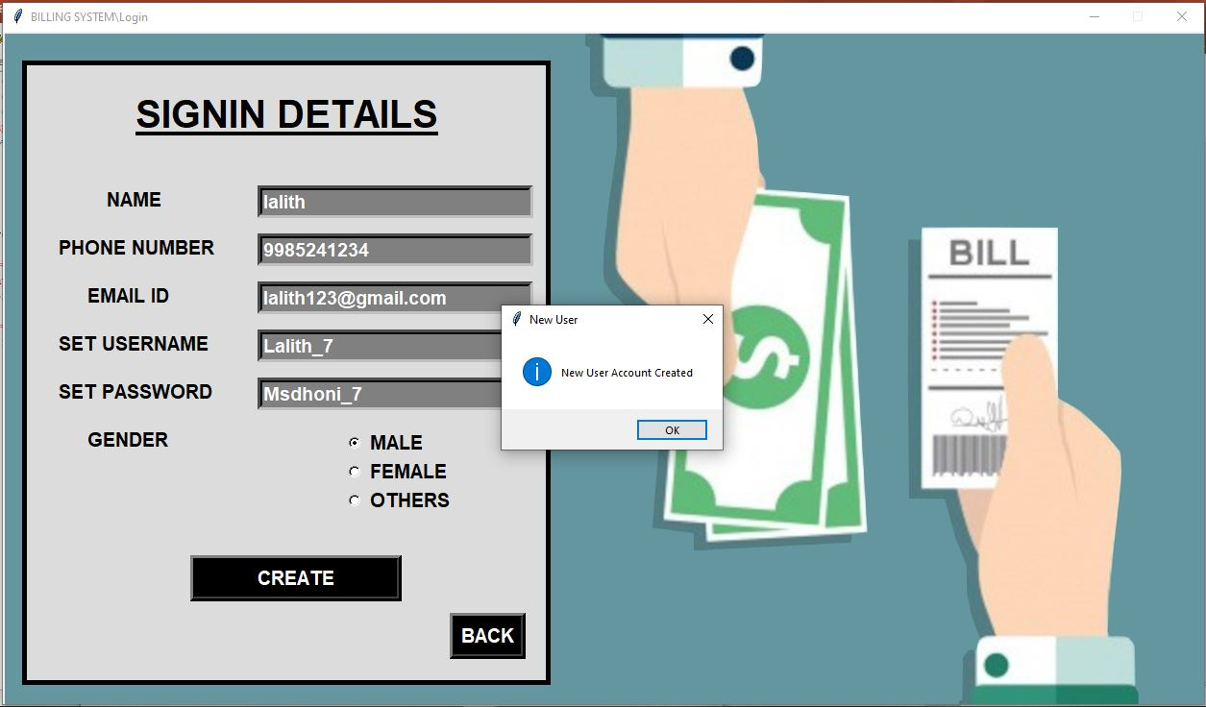
SIGNIN INTERFACE (for new users) :

Slide 10
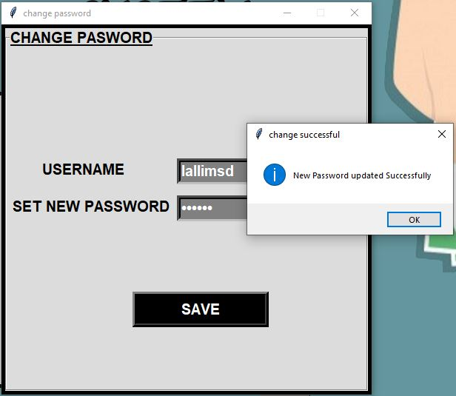
PASSWORD CHANGE INTERFACE:

